Slide 1
Instruction set of 8086

Slide 2
The Instruction set of 8086:-
Data transfer instructions
Arithmetic instructions
Logical Instructions

Slide 3
Data transfer instructions
General purpose instructions:
MOV − Used to copy the byte or word from the provided source to the provided destination.
-syntax- MOV destination,source
Ex:-MOV AX,BX; contents of bx moved to ax.
PUSH − Used to put a word at the top of the stack.
Ex:-push AX; contents Ax reg moved to the stack.
POP − Used to get a word from the top of the stack to the provided location.
Eg:-pop Ax; contents from top of stack moved to AX.
XCHG − Used to exchange the data from two locations.
Eg:-XCHG ax,bx

Slide 4
Data transfer instructions..contd
B. Instructions for input and output port transfer
IN − Used to read a byte or word from the provided port to the accumulator(AX register).
OUT − Used to send out a byte or word from the accumulator to the provided port.
C. Instructions to transfer the address
LEA − Used to load the address of operand into the provided register.
LDS − Used to load DS register and other provided register from the memory
LES − Used to load ES register and other provided register from the memory.

Slide 5
Data transfer instructions..contd
D. Instructions to transfer flag registers
LAHF − Used to load AH with the low byte of the flag register.
SAHF − Used to store AH register to low byte of the flag register.
PUSHF − Used to copy the flag register at the top of the stack.
POPF − Used to copy a word at the top of the stack to the flag register.

Slide 6
Instruction :POP Destination
This instruction copies a word from memory location pointed by SS:SP to the destination-LIFO
The segment register used with SP is SS , and no segment override is possible (use some other segment register than the default segment for a particular code).
When it is executed:
Data from memory location (in stack segment) SS:SP is first copied to the destination
And then SP is incremented by 2 (SP=SP+2)
Note : destination can be a general purpose register, Flag register ,segment register or memory location .
EX: POP AX (store the value of stack in AX)
POP DS

Slide 7
Instruction :PUSH Source
When this instruction is executed:
SP=SP-2 (i.e. First SP is decremented by 2 )
Copy the word from source register to the location in Stack Segment where SP points.
Note :1.Source operand (16-bit) can be a general purpose register, Flag register ,segment register or memory .
2. Addressing mode – register Indirect
EX: PUSH AX (content of AX is moved to stack)
PUSH BX
PUSH DS

Slide 8
XCHG
XCHG Reg2,Reg1
Contents of Reg1 are exchanged with Reg2.
Both Reg’s should be of same size.
Both can be ether 8 bit or 16 bit.
Eg:-XCHG AL,BL
XCHG [BX],AX
BX-pointing register also

Slide 9
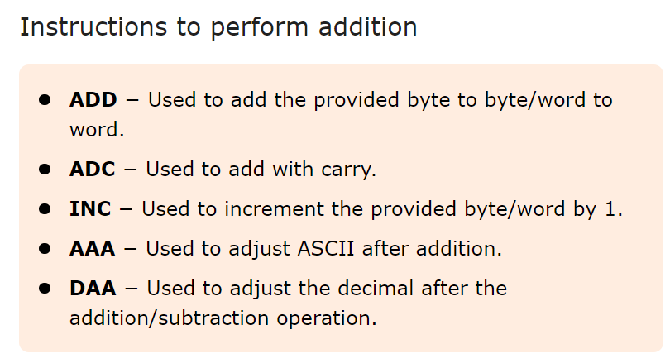
ARITHMETIC INSTRUCTIONS 1.instructions to perform addition

Slide 10
ADDITION instructions..cntd
ADD
Ex ADD AX,BX
AX<= AX+BX
ADC
Ex ADD AX,BX
AX<= AX+BX+CF
INC
Ex: INC CL (content of CL +1)
CL<= CL+1
INC BX
BX<= BX+1
AAA
DAA

Slide 11
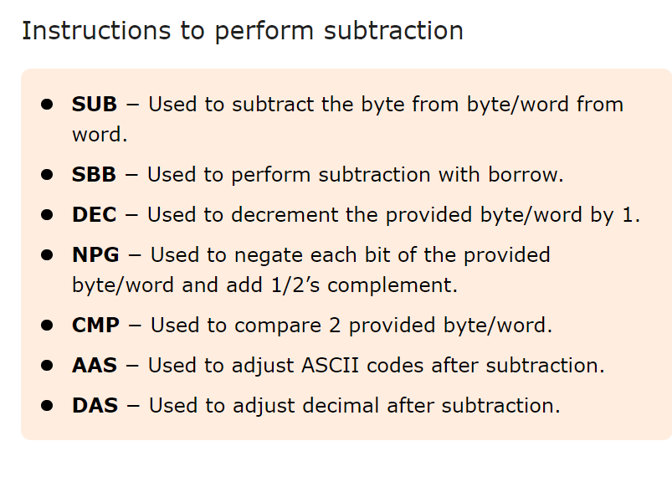
2.Instructions to perform subtraction

Slide 12
SUBTRACT INSTRUCTIONS
1.SUB
Eg:-SUB ax, bx ; Subtracts bx from ax and stores result in ax.
2.SBB ax,bx ; Subtracts bx and borrow(carry flag) from ax and stores result in ax.
3.CMP ax,bx ; comparison is done by subtracting bx from ax and checking the flags.
-If ax<bx –carry flag set
-ax=bx, zero flag set

Slide 13
SUBTRACT INSTRUCTIONS
4.dec
Eg: DEC ax- Decrements the value of ax by 1.

Slide 14
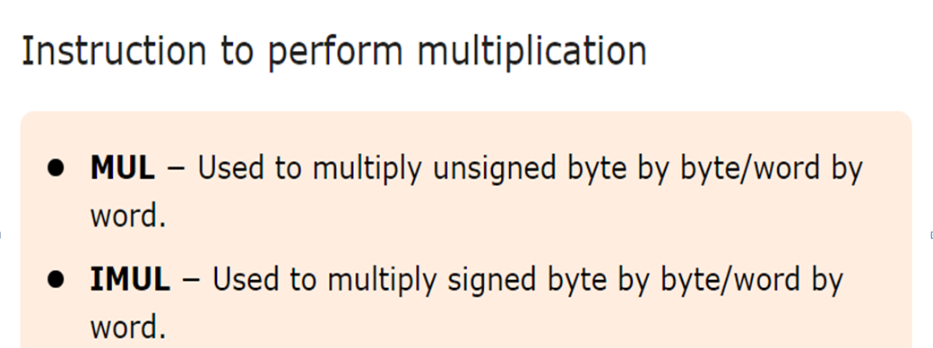
3.Instruction to perform Multiplication

Slide 15
MULTIPLICATION
Eg:-1.Mul bl
Multiplies AL by BL and stores the result in AX.
2.Mul bx
Multiplies ax with bx and stores the lower word of the result in Ax and higher word in DX.

Slide 16
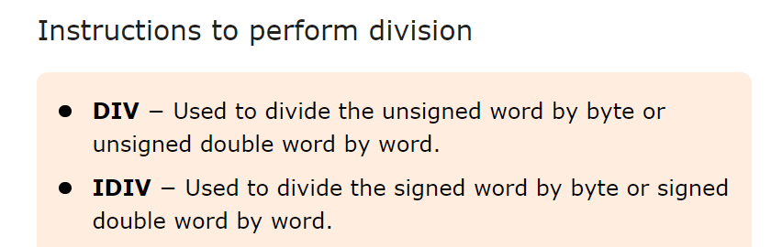
4.Instrutions for Division

Slide 17
DIVISION
Eg:-Div BL
-AL is divided by BL and the quotient is stored in AL and the reminder in AH register.
Eg:-Div BX
-Ax is divided by BX and the Quotient is stored in AX and the reminder in DX.

Slide 18
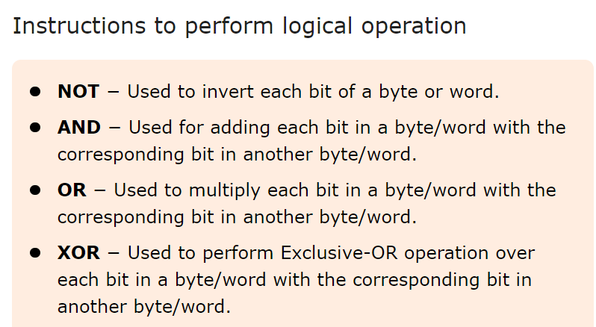
Logical Instructions

